Slide 1
Resume Workshop
Amber Falise, Career Development Coordinator
Wilkes County Schools
falisea@wilkes.k12.nc.us

Slide 2
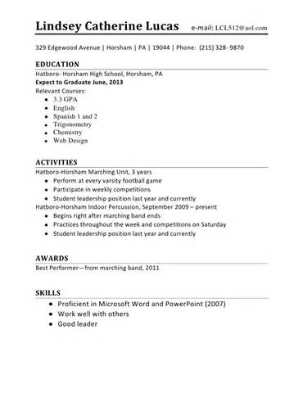
Resume what?
A resume is a marketing tool
Clearly states your abilities
Creates talking points for future interviews
Be honest & truthful as you develop your resume
Know the position you’re applying for… employers want to know what you can do for the company
Past performance is an indicator of future success
How can you contribute to the company

Slide 3
Purpose of Resume
To get the interview NOT to get hired

Slide 4
Types of Resumes
Chronological Resume
Functional Resume
Combination Resume
Master Resume – General
Target Resume – Specific to a job
We will learn to develop a
Master/Chronological Resume

Slide 5
Explanation…
Chronological Resume
Most common and most popular among employers
Reverse chronological order
List education first, then work experience (new grads)
Use skills section to highlight skills you have
A Master Resume is a general resume that is not specific to a particular job
Include all work-related skills, activities, experiences, responsibilities
Study job postings
Use key words

Slide 6
Resume Basics
Header:
Name, address, email, ph. #
Skills:
Computer, language, community service/volunteer experience, soft skills
APPROPRIATE
Education:
School, expected grad. date, relevant/WCC coursework & GPA if greater than 3.3
Achievements:
Honor Grad, Student of the Month, National Technical Honor Society, Beta Club, Governor’s School, WorkKeys Certificate, CTE certifications, CPR, First Aid
Work Experience:
Name of company, city & state, 3-7 bullet points describing your responsibilities, include internship experience
References:
NO! NO! NO!

Slide 7
Listing Work Experience
Job Title is BOLD
Use the following format:
Childcare Provider, Company, Wilkesboro, NC Oct. 2015-present
Managed three to four hours of after school activities for a six year old child ensuring homework was completed accurately.
Sales Associate, Bubble Gum Shop, Coolville, NC June 2015-Oct.2015
Assisted customers by answer questions, suggesting bubble gum flavors, and checking them out efficiently.

Slide 8
Summary Statement/Qualifications Summary
First, traditional Objective statements are considered obsolete by many employers
Incorporate key words from job description if you can
Describe your skills & experience in 2-3 sentences, grab employer’s attention
Recent graduate and self-starter effectively functioning with minimum supervision. Known for taking initiative and highly organized. A team player who is attentive to detail and produces quality results. Computer proficient. Areas of expertise include:
• Customer Service • Detail Oriented • Time Management
• Multi Tasking • Microsoft Office • Written and Verbal Comm.

Slide 9
You also need to know…
Unpaid work experience such as internships are still work experience
Your resume represents you when you’re not there!
Be neat, succinct, use correct grammar and keep it to one page
Employers scan your resume for an average time of 7-10 seconds
What job are you applying for? Did you read the job description? Use terminology in the job description in your resume if you can
Use data when you can
Don’t list references

Slide 10
More you need to know…
Use adjectives when describing your work experience
Pay attention to formatting – name should be bigger than other words, use white space, easy to read font, attractive
Have someone else proof read your resume
No perfect resume – all unique
Work Experience, Community Service, Volunteer Work: TITLES CAN VARY
No PHOTOS
Graphics can be used sparingly…a line or two looks good

Slide 11
Market yourself right!
Resume
Cover Letter
Online Profile
Pitch

Slide 12
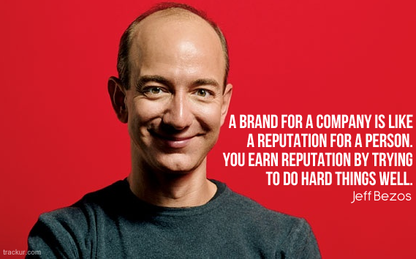
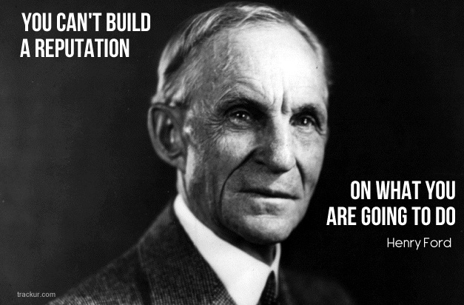
Food for thought…
http://www.trackur.com/reputation-management-quotes

Slide 13
Online Resources
www.cfnc.org
www.onetonline.org
www.mynextmove.org
Google images for chronological resumes, high school students

Slide 14
Resources
http://community.alison.com/2016/02/17/how-to-create-a-winning-resume/#.VstLxfKLSUl?utm_campaign=523_how_to_resume&utm_source=outbound+marketing&utm_medium=email/
https://www.lorainccc.edu/NR/rdonlyres/B66F95F9-26F5-4326-98C4-4E8711255D88/1448/SummaryStatementsforexperienceresumeGeneral.pdf
http://community.alison.com/2016/02/17/how-to-create-a-winning-resume/#.VstLxfKLSUl?utm_campaign=523_how_to_resume&utm_source=outbound+marketing&utm_medium=email/
Webinar, Opening Doors with Your Resume: Exploring Types of Resumes, NC Works Training Center

